Slide 1
Q3 2019 MLCC Market Update
Presented by
Jeff Ray
VP Product Management
& Supplier Marketing
The information contained herein is the confidential property of TTI and its subsidiaries. Contents may not be distributed or repeated by third-parties without the consent of TTI, Inc.

Slide 2
Q3 2019 MLCC Market Update
1
Constrained Market Causal Factors
2
Market Availability Trends
3
Vertical Market Consumption
4
Alternative Technology Options

Slide 3
Q3 2019 MLCC Market Update
Constrained Market Stemmed from Increased Output with Flat Revenues
  MLCC unit output increased approximately 50% from 2011 to 2016 while revenues remained flat
  Given the overall ROI on adding capacity, the market leading MLCC manufacturers developed new more measured strategies targeting:
    Vertical Market Targets
    Specific Case Size Ranges
    Capacitance Values & Voltages
Billions
Trillions

Slide 4

Q3 2019 MLCC Market Update
Advanced Technology Applications are Driving Growth in Units and Capacitance
5G Infrastructure 4G to 5G
Remote Radio Unit (RRU)
Units: 2,000 to 6,000 MLCCs per unit
Baseband Unit (BBU)
Units: 3,000 to 5,000 MLCCs per unit
Servers, Big Data and A.I.
Units: 1,800 to 3,500 MLCCs per board
Capacitance: 15,000μf to 30,000μf per board
Vehicles, Internal Combustion to Electric
Units: 2,900 units to 15,000 MLCCs per vehicle
Capacitance: 2,000μf to 40,200μf per vehicle
Cellular Phones
Units: 400 units to 1,100 MLCCs per device
Capacitance: 1,250μf to 3,450μf per device

Slide 5
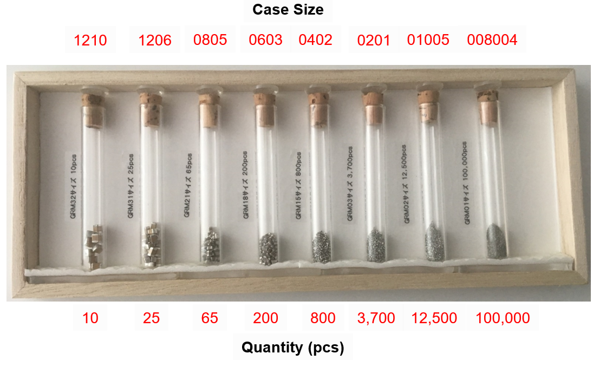
Q3 2019 MLCC Market Update ~ Product Life Cycles
MLCC Capacity is Being Redirected to Smaller, More Economical Case Sizes
Volumetric efficiencies gained from the intentional downsizing of the market:
1206 to 0603 = 800% increase
1206 to 0402 = 3,200% increase

Slide 6
Q3 2019 MLCC Market Update
1
Constrained Market Causal Factors
2
Market Availability Trends
3
Vertical Market Consumption
4
Alternative Technology Options

Slide 7
Q3 2019 MLCC Market Update
Breaking Down the World of MLCCs to Identify Potential Supply Chain Issues
To outline potentially problematic areas within the world of MLCCs we must organize the market in categories based on capacitance value, case size and grade:
  Capacitance value (CV) defined as low and high, low CV have a value of <1μF, high CV are 1μF and greater
  Case sizes range from 008004 to 6040, in North America the more prevalent case sizes are 0201 to 1210; small are case size 0402 and smaller, large case are 0603 and larger
  Commercial vs. specialty are two fundamental grades of MLCCs; commercial are standard components and specialty have automotive-rated and/or flexible terminations that resist cracking in applications in shock and vibration environments

Slide 8
Q3 2019 MLCC Market Update
MLCC Availability by Case Size, CV Rating and Grade
LOW CV (<1uF)
HIGH CV (>1uF)
Commercial Grade PRODUCT IS AVAILABLE AVX • KEMET • Murata • Vishay • Yageo | Commercial Grade AVAILABLE / VERIFY DELIVERY AVX • KEMET • Murata • TDK
Specialty Grade (Auto & Flex) AVAILABLE / VERIFY DELIVERY AVX • KEMET • Murata • TDK • Vishay • Yageo | Specialty Grade (Auto & Flex) AVAILABLE / VERIFY DELIVERY AVX • KEMET • Murata
Commercial Grade AVAILABLE / VERIFY DELIVERY AVX • KEMET • Murata • Vishay • Yageo | Commercial Grade AVAILABLE / VERIFY DELIVERY AVX • KEMET • Murata • TDK
Specialty Grade (Auto & Flex) CONSTRAINED AVX • KEMET • Murata • TDK | Specialty Grade (Auto & Flex) CONSTRAINED TO VERY CONSTRAINED AVX • KEMET • Murata
01005 -- 0402
0201-- 0402
0603 --1210
0603 --1210

Slide 9
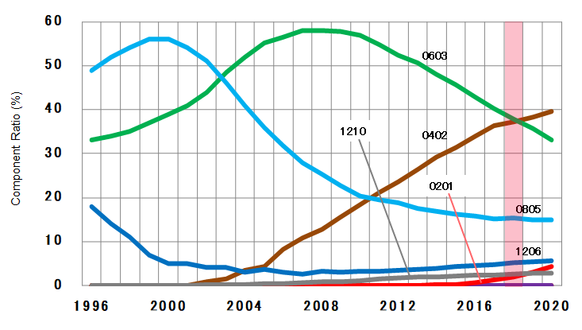
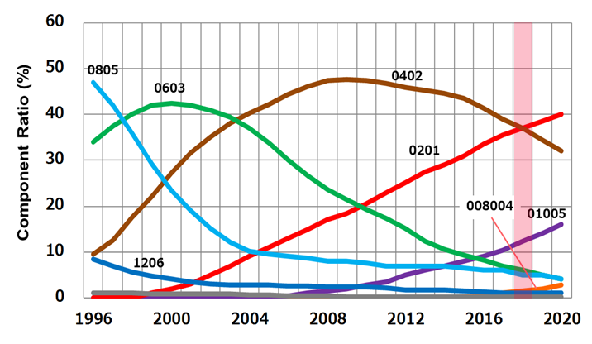
Q3 2019 MLCC Market Update
  0201 and Smaller Case Size MLCCs are Growing at 22.3% CAGR
  More than 2X the Growth Rate of Larger Case Sizes
Automotive Grade
MLCC Case Size Life Cycles
Commercial Grade
MLCC Case Size Life Cycles

Slide 10
Q3 2019 MLCC Market Update
The Americas’ MLCC Requirements and Consumption Differ from Global Usage
  Globally roughly 3 trillion pieces of the annual 4.3 trillion MLCCs produced are 0201 and smaller case sizes and largely for the consumer device market
  In North America, particularly the industrial, military, and transportation markets, we are larger consumers of the 0402, 0603, 0805 and 1206 case sizes
Percent of Sales by
Case Size in North America

Slide 11
Q3 2019 MLCC Market Update
1
Constrained Market Causal Factors
2
Market Availability Trends
3
Vertical Market Consumption
4
Alternative Technology Options

Slide 12
Q3 2019 MLCC Market Update
MLCC Manufacturers are Targeting Specific Vertical Markets for Growth
Manufacturers of multilayer ceramic capacitors are concentrating both existing production capacity and product development roadmaps on specific vertical markets, case sizes and capacitance ranges. It is crucial that TTI’s customers understand the paths forward and adjust their procurement and design strategies to mitigate their risk of supply chain interruption today and ensure their alignment with the future of this technology.
The next few slides detail the direction of the transportation, computing and industrial market segments, highlighting the growth and technology drivers, as well as the popular MLCC used in these verticals.

Slide 13

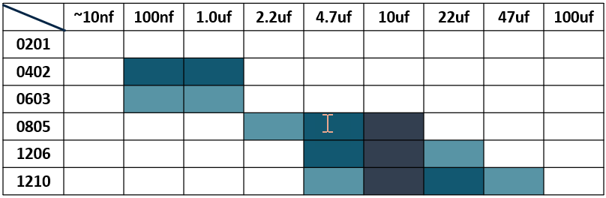
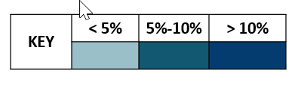
Q3 2019 MLCC Market Update
MLCC Transportation Market
Market growth drivers: increased electronic content, EV and ADAS
Technology trends: smaller sizes, higher capacitance, high temperature
The majority of MLCCs consumed in transportation applications are in these case sizes and cap values

Slide 14

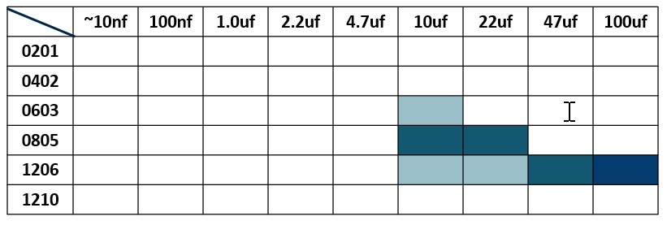
Q3 2019 MLCC Market Update
MLCC Computing Market
Market growth drivers: higher speed networking
Technology trends: high capacitance values, high temperature
The majority of MLCCs consumed in computing applications are in these case sizes and cap values

Slide 15
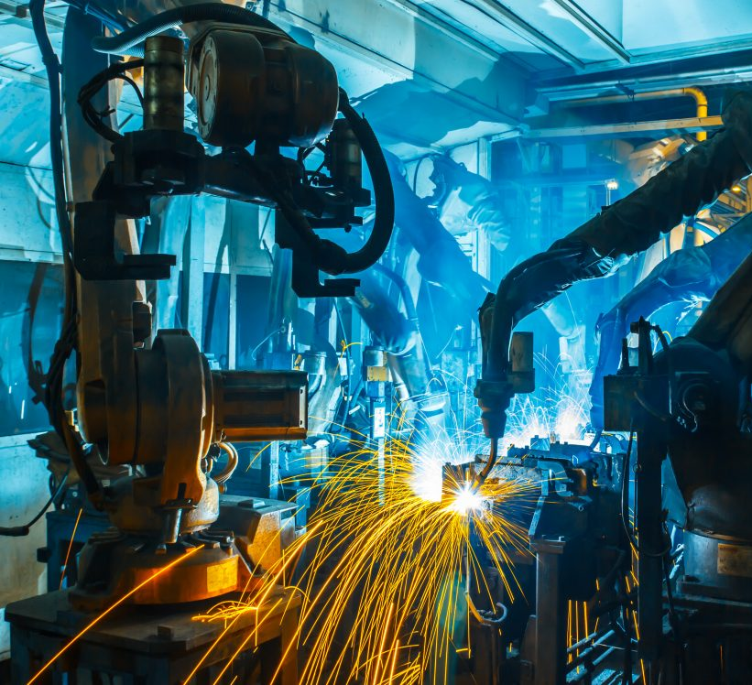
Q3 2019 MLCC Market Update
MLCC Industrial Market
Market growth drivers: Industrial IoT, lighting, security, energy management
Technology trends: high temperature, high vibration/shock, high voltage
The majority of MLCCs consumed in industrial applications are in these case sizes and cap values

Slide 16
Q3 2019 MLCC Market Update
1
Constrained Market Causal Factors
2
Market Availability Trends
3
Vertical Market Consumption
4
Alternative Technology Options

Slide 17
Q3 2019 MLCC Market Update
Is Your Design Affected by Shortages in the MLCC Market?
YES
Qualify alternate suppliers immediately, evaluate upgrades:
Can you use a higher voltage part
Can you use a tighter tolerance part
Is AECQ200 required or an option
Is a flexible termination required
Can your design accept:
Alternate supplier
Product upgrade
YES
NO
Can your design accept a smaller package?
Determine if your pad layout will accommodate 0402 or smaller.
YES
NO
First option = smaller pads
Second option = alternative technology
Can you re-design?
YES

Slide 18
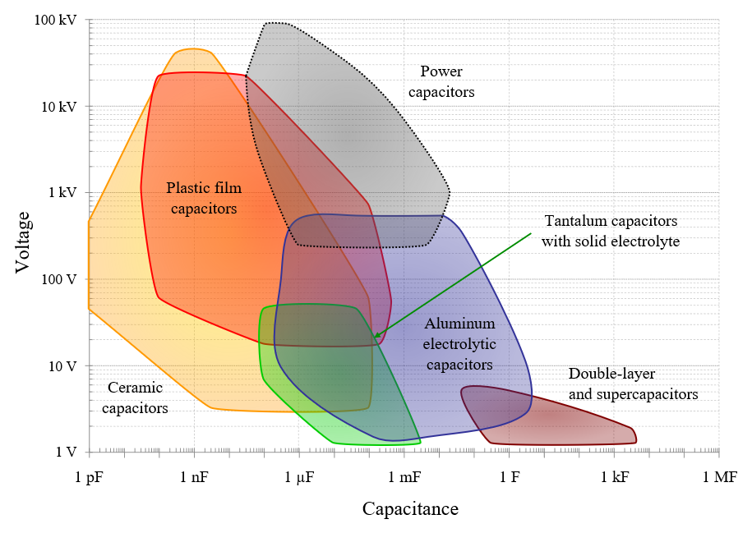
Q3 2019 MLCC Market Update
Alternative Capacitor Technologies
Affected Voltage and Capacitance Range for Constrained and Allocated MLCCs
Tantalum (MnO2)
  Cost effective when de-rated properly (50% voltage)
  A-case generally fits 1206 pads
Tantalum Polymer
  Low ESR
  No ignition
  High capacitance
  (10%-20% V de-rating)
Aluminum Polymer
  Very low ESR
  Good for low voltage applications
Film
  Good for higher voltages
  Robust with long life
SMT Aluminum Electrolytic
  Good for bulk decoupling and higher voltages
Power
Capacitors
Ceramic
Capacitors
MLCC

Slide 19
Thank You

